Slide 1

Course Instructor- Dr. Sivasankar P. Presented by- Manish Kumar
EOR Screening using Classification and Clustering
Enhanced Oil Recovery
Dept. of Petroleum Engineering
Indian Institute of Petroleum and Energy
Visakhapatnam-530003

Slide 2
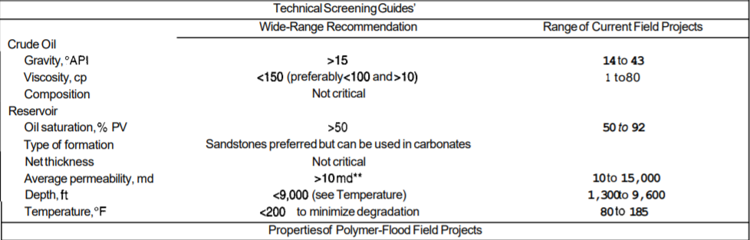
Introduction
Initial step of EOR selection
Conventionally go/no/go approach was used
Used range of Reservoir & fluid parameters to filter EOR methods
ML can find hidden patterns
Fig 1. Selection Criteria for Polymer flooding Taber et al. in 1997

Slide 3
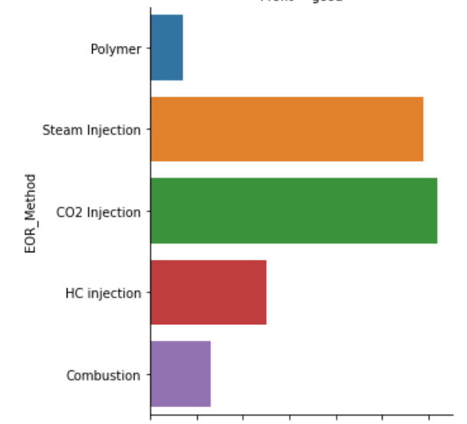
Data Preparation and Analysis
Establishing a dataset is a challenge
Dataset with 203 samples
Various Pre processing steps
CO2 and Steam injection most widely implemented

Slide 4
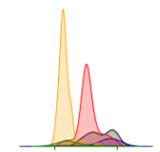
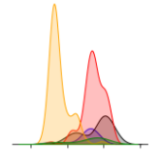
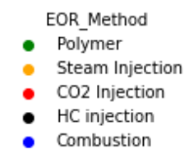
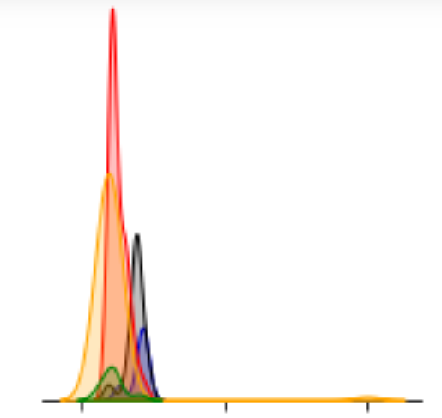
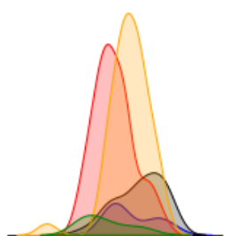
Some Visible Trends
Oil Saturation HC>Steam>CO2 injection>Combustion>Polymer
Temperature Combustion>HC Injection>CO2 injection>Polymer>Steam
Gravity HC injection->CO2 Injection->Polymer->Combustion->Steam Injection
Depth HC injection->Combustion->CO2 Injection->Polymer->Steam Injection
Depth
Gravity
Temperature
Oil Saturation

Slide 5
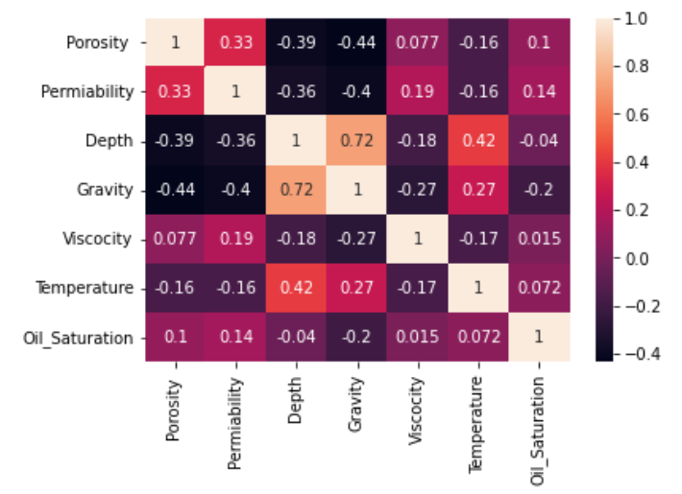
Correlation between various features

Slide 6
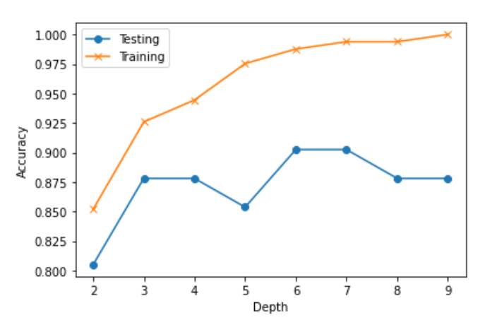
Splitting data and Training
20 % of dataset was used as test data
Split was stratified to ensure uniform proportional splitting
Random Forest Classifier was used to train the data
Training accuracy of 98.76% and testing accuracy of 90.24%
Fig Accuracy vs Max depth

Slide 7
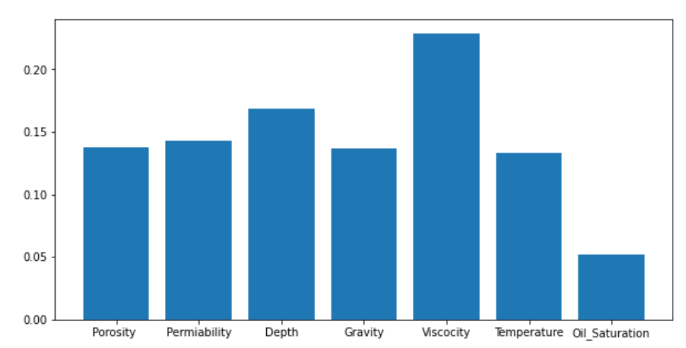
Feature Importance

Slide 8
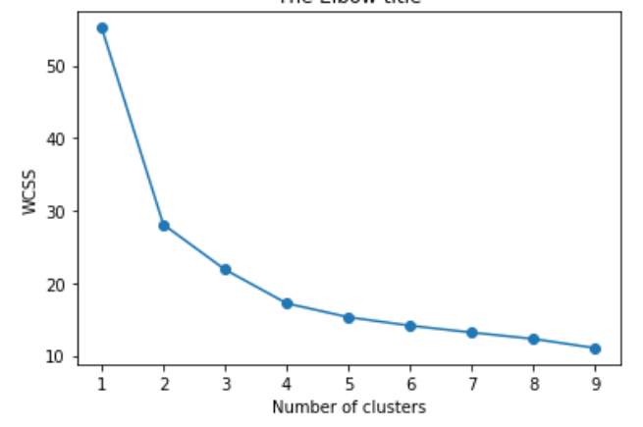
Analysing through clustering
Data is scaled by Min Max Scaler
KMeans algorithm was used
Numbers of clusters were 5
Generated Similar results

Slide 9
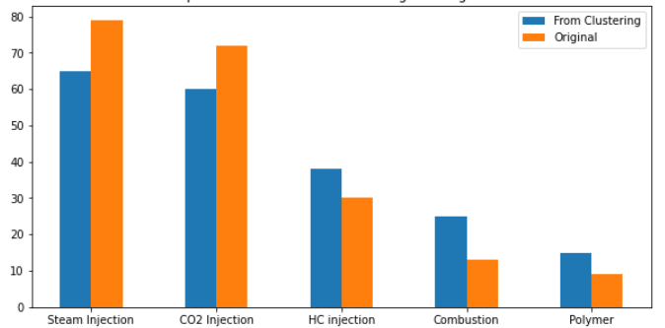
Comparison of result from Clustering and original data

Slide 10
References
Taber, J.J., Martin, F.D., and R.S. Seright. "EOR Screening Criteria Revisited—Part 2: Applications and Impact of Oil Prices." SPE Res Eng 12 (1997): 199–206. doi: https://doi.org/10.2118/39234-PA
Development of a hybrid scoring system for EOR screening by combining conventional screening guidelines and random forest algorithm https://doi.org/10.1016/j.fuel.2019.115915

Slide 11
Thank You

